Slide 1









TEAM NAME: NEXUS AURA
COLLEGE NAME: SRI VENKATESWARA COLLEGE OF ENGINEERING
PROBLEM STATEMENT:
PEOPLE STORE IMPORTANT PERSONAL DOCUMENTS ACROSS DIFFERENT PLATFORMS LIKE EMAILS AND CLOUD DRIVES, MAKING THEM HARD TO MANAGE, AND DIFFICULT TO VERIFY. THERE IS A NEED FOR A SECURE AND INTELLIGENT DIGITAL VAULT THAT CAN ORGANIZE, PROTECT, AND VERIFY PERSONAL DOCUMENTS WHILE GIVING USERS FULL CONTROL OVER THEIR DATA.

Slide 2

PROBLEM STATEMENT
Forum Of Data Science Engineers
In today’s digital world, individuals store important personal documents such as certificates, identification documents, academic records, resumes, and contracts across multiple platforms like email, cloud drives, and messaging apps. This scattered storage leads to several challenges including poor organization, security risks, difficulty in document verification, and lack of control over personal data sharing.
Many existing storage systems focus only on file storage, but they do not provide intelligent features such as automated document understanding, secure verification, controlled sharing, and data ownership protection.
Therefore, there is a need for a secure, intelligent, and user-centric digital vault that allows individuals to store, organize, verify, and manage their digital identity and important documents in one place while ensuring privacy and authenticity.

Slide 3
SOLUTION
Obscura is an AI-powered secure digital identity vault that allows users to store, manage, and verify important personal documents in a centralized and secure platform.
The system will :
• securely store sensitive documents using encryption
• automatically analyze and categorize documents using AI
• detect potential document tampering using cryptographic hashing
• allow secure document sharing with controlled access
• provide intelligent search to quickly find stored documents
• automatically generate a professional resume, portfolio website (e.g., portfolio.yourname.app), and a LinkedIn-style profile summary from uploaded certificates, projects, and achievements
By combining AI, secure storage, and intelligent document processing, Obscura transforms simple document storage into a smart digital identity management platform that helps users both protect and showcase their achievements.
Forum Of Data Science Engineers

Slide 4
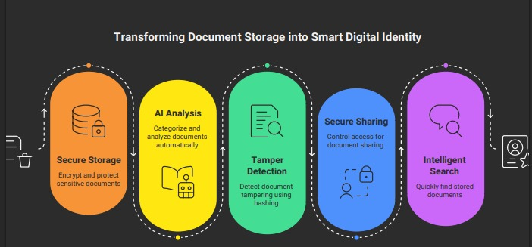
FLOW DIAGRAM
Forum Of Data Science Engineers

Slide 5
TECHNICAL REQUIREMENTS
1. Frontend Technologies
HTML, CSS, and JavaScript for building the basic structure and styling of the web application.
React.js to create a responsive and interactive user interface for document management and user interaction.
2. Backend Technologies
Node.js to develop the server-side logic.
Handles user authentication, document processing, API integration, and communication with the database and blockchain network.
3. Database & Cloud Storage
MongoDB / Firebase for storing user information and document metadata.
Cloud storage services for securely storing uploaded documents and enabling scalable data management.
4. Artificial Intelligence Integration
Machine Learning algorithms for automatic document categorization and organization.
OCR (Optical Character Recognition) technology to extract text from uploaded documents for indexing and search functionality.
5. Blockchain Security
Blockchain network to store document hashes, ensuring tamper-proof verification of documents.
Smart contracts to enable secure and transparent document validation.
Forum Of Data Science Engineers

Slide 6
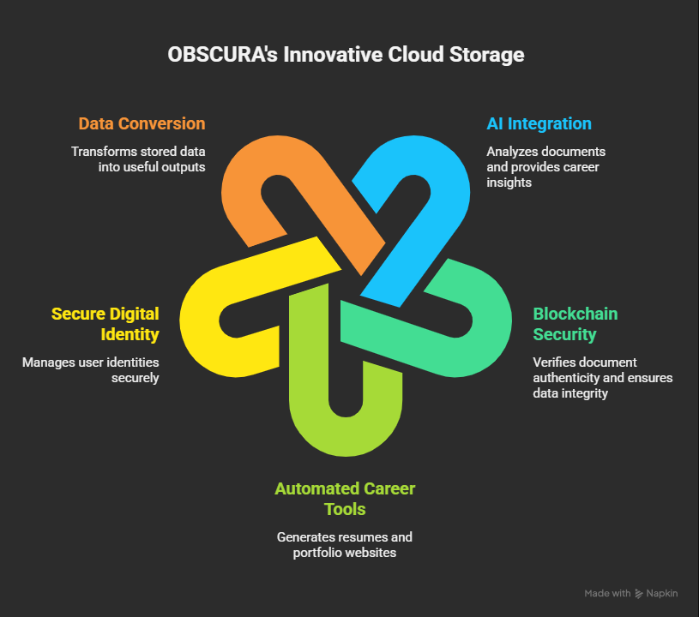
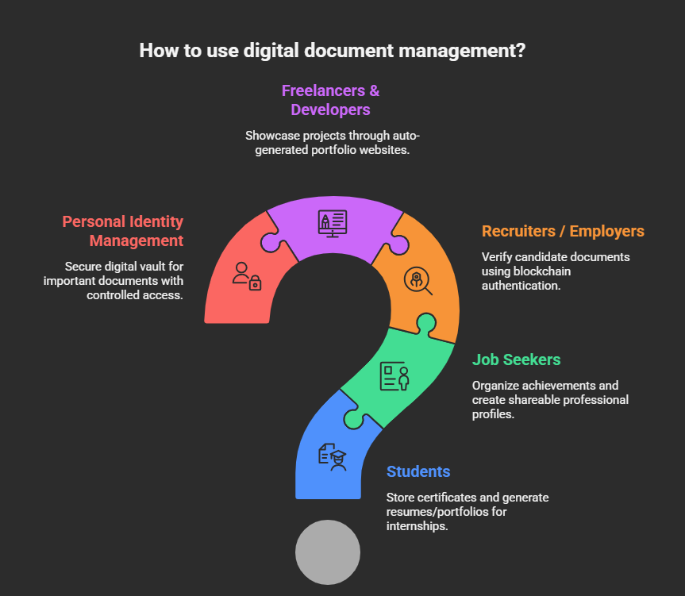
NOVELTY / USE CASE
Forum Of Data Science Engineers

Slide 7
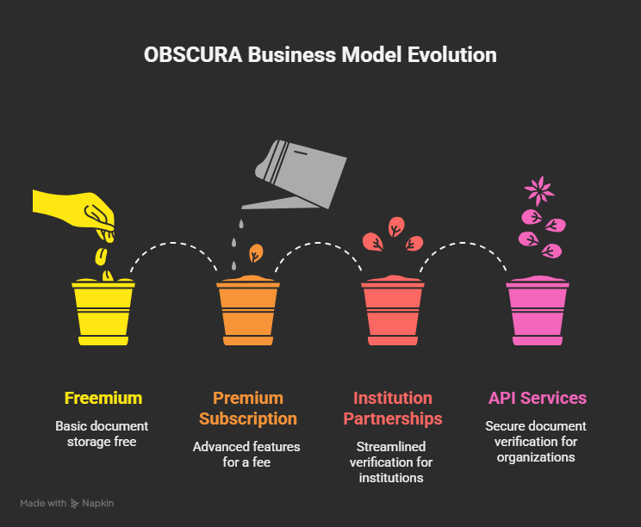
BUSINESS MODEL / TARGET MARKET
Forum Of Data Science Engineers
D E S I G N . D E V E L O P . D E P L O Y

Slide 8
TEAM DETAILS
Forum Of Data Science Engineers
NAME | COLLEGE | DEPARTMENT | MOBILE NUMBER | E MAIL ID
S.SHRUTHIKAA | SRI VENKATESWARA COLLEGE OF ENGINEERING | CSE | 9176411888 | 2025cs0846@svce.ac.in
S.PUJA | SRI VENKATESWARA COLLEGE OF ENGINEERING | CSE | 9345702256 | 2025cs0851@svce.ac.in
R.SAINETHRA | SRI VENKATESWARA COLLEGE OF ENGINEERING | CSE | 7010538654 | 2025cs0869@svce.ac.in
R.SAI HAMSITHA | SRI VENKATESWARA COLLEGE OF ENGINEERING | CSE | 8056935129 | 2025cs0234@svce.ac.in
SANJANASRI M | SRI VENKATESWARA COLLEGE OF ENGINEERING | AD | 9944272743 | 2025ad0936@svce.ac.in
ROLE
NAME
STREAM/DEPT
YEAR
COLLEGE

